Slide 1
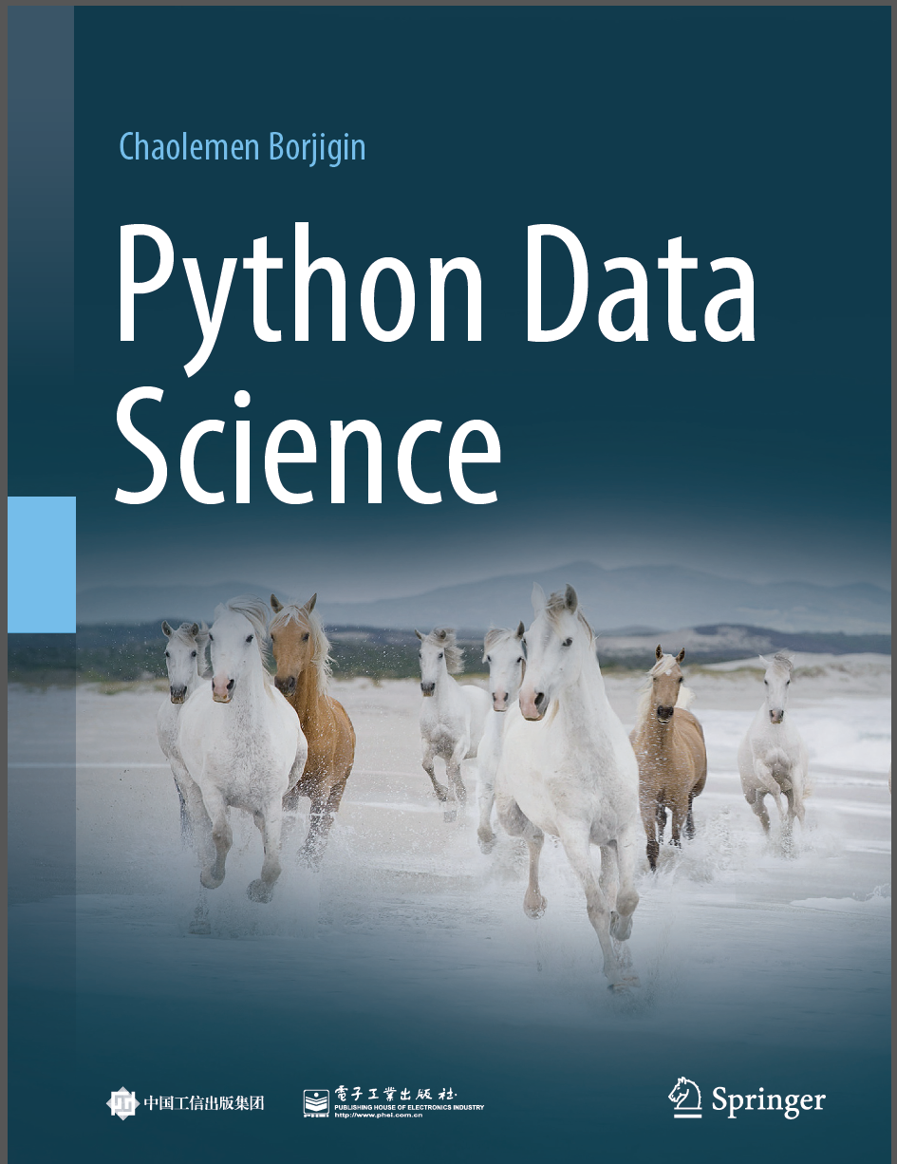
Python Programming —— From Data Analysis to Data Science
Chaolemen Borjigin
Renmin University of China
chaolemen@ruc.edu.cn

Slide 2
5.2 Machine learning with scikit-learn
Chaolemen Borjigin
Renmin University of China
chaolemen@ruc.edu.cn

Slide 3
Summary of this chapter
▼Chapter 5 Data analysis with Python
► 5.2 Machine learning with scikit-learn
5.2.1 Business understanding
5.2.2 Data loading
5.2.3 Data understanding
5.2.4 Data wrangling
5.2.5 Model selection and hyperparameter tuning

Slide 4
Summary of this chapter
▼Chapter 5 Data analysis with Python
► 5.2 Machine learning with scikit-learn
5.2.6 Model training
5.2.7 Predicting with a trained model
5.2.8 Model evaluation
5.2.9 Model optimization and application

Slide 5
5.2.1 Business understanding
▼Chapter 5 Data analysis with Python
► 5.2 Machine learning with scikit-learn
The dataset involves the columns(attributes) such as ID number, Diagnosis
(M = malignant, B = benign) and 10 real-valued features are calculated for each cell nucleus. They are:
1) radius (mean of distances from the center to points on the perimeter)
2) texture (standard deviation of gray-scale values)
3) perimeter
4) area
5) smoothness (local variation in radius lengths)
6) compactness (perimeter^2 / area - 1.0)
7) concavity (severity of concave portions of the contour)
8) concave points (number of concave portions of the contour)
9) symmetry
10) fractal dimension (“coastline approximation” - 1)

Slide 6
5.2.2 Data loading
▼Chapter 5 Data analysis with Python
► 5.2 Machine learning with scikit-learn
In[4]:
import pandas as pd
import numpy as np
import os
os.chdir(r'C:\Users\soloman\clm')
print(os.getcwd())
C:\Users\soloman\clm

Slide 7
5.2.2 Data loading
▼Chapter 5 Data analysis with Python
► 5.2 Machine learning with scikit-learn
In[5]:
bc_data = pd.read_csv('bc_data.csv', header=0)
bc_data.head()
Out[5]:
id | diagnosis | radius_mean | texture_mean | perimeter_mean | area_mean | smoothness_mean | compactness_mean | concavity_mean | concave points_mean | ... | radius_worst | texture_worst | perimeter_worst | area_worst | smoothness_worst | compactness_worst | concavity_worst | concave_points_worst | symmetry_worst | fractal_dimension_worst
0 | 842302 | M | 17.99 | 10.38 | 122.80 | 1001.0 | 0.11840 | 0.27760 | 0.3001 | 0.14710 | ... | 25.38 | 17.33 | 184.60 | 2019.0 | 0.1622 | 0.6656 | 0.7119 | 0.2654 | 0.4601 | 0.11890
1 | 842517 | M | 20.57 | 17.77 | 132.90 | 1326.0 | 0.08474 | 0.07864 | 0.0869 | 0.07017 | ... | 24.99 | 23.41 | 158.80 | 1956.0 | 0.1238 | 0.1866 | 0.2416 | 0.1860 | 0.2750 | 0.08902
2 | 84300903 | M | 19.69 | 21.25 | 130.00 | 1203.0 | 0.10960 | 0.15990 | 0.1974 | 0.12790 | ... | 23.57 | 25.53 | 152.50 | 1709.0 | 0.1444 | 0.4245 | 0.4504 | 0.2430 | 0.3613 | 0.08758
3 | 84348301 | M | 11.42 | 20.38 | 77.58 | 386.1 | 0.14250 | 0.28390 | 0.2414 | 0.10520 | ... | 14.91 | 26.50 | 98.87 | 567.7 | 0.2098 | 0.8663 | 0.6869 | 0.2575 | 0.6638 | 0.17300
4 | 84358402 | M | 20.29 | 14.34 | 135.10 | 1297.0 | 0.10030 | 0.13280 | 0.1980 | 0.10430 | ... | 22.54 | 16.67 | 152.20 | 1575.0 | 0.1374 | 0.2050 | 0.4000 | 0.1625 | 0.2364 | 0.07678

Slide 8
5.2.3 Data understanding
▼Chapter 5 Data analysis with Python
► 5.2 Machine learning with scikit-learn
In[6]:
print(bc_data.shape)
(569, 32)
In[7]:
print(bc_data.columns)
Index(['id', 'diagnosis', 'radius_mean', 'texture_mean', 'perimeter_mean',
'area_mean', 'smoothness_mean', 'compactness_mean', 'concavity_mean',
'concave points_mean', 'symmetry_mean', 'fractal_dimension_mean',
'radius_se', 'texture_se', 'perimeter_se', 'area_se', 'smoothness_se',
'compactness_se', 'concavity_se', 'concave points_se', 'symmetry_se',
'fractal_dimension_se', 'radius_worst', 'texture_worst',
'perimeter_worst', 'area_worst', 'smoothness_worst',
'compactness_worst', 'concavity_worst', 'concave_points_worst',
'symmetry_worst', 'fractal_dimension_worst'],
dtype='object')

Slide 9
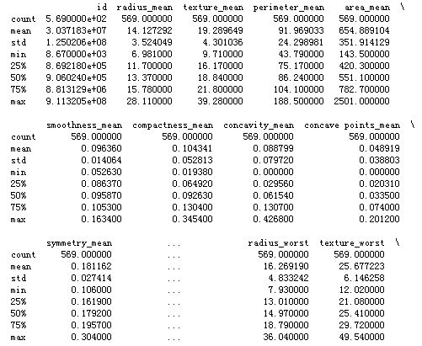
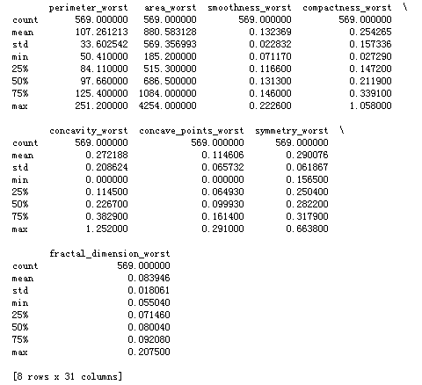
5.2.3 Data understanding
▼Chapter 5 Data analysis with Python
► 5.2 Machine learning with scikit-learn
In[8]:
print(bc_data.describe())

Slide 10
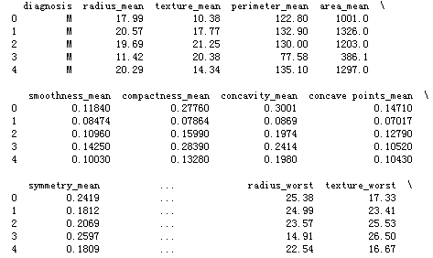
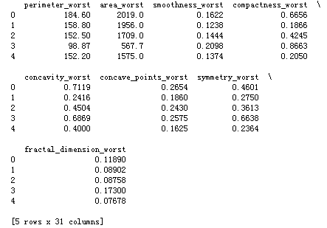
5.2.4 Data wrangling
▼Chapter 5 Data analysis with Python
► 5.2 Machine learning with scikit-learn
In[10]:
data = bc_data.drop(['id'], axis=1)
print(data.head())

Slide 11
5.2.4 Data wrangling
▼Chapter 5 Data analysis with Python
► 5.2 Machine learning with scikit-learn
In[11]:
X_data = data.drop(['diagnosis'], axis=1)
X_data.head()
Out[11]:
radius_mean | texture_mean | perimeter_mean | area_mean | smoothness_mean | compactness_mean | concavity_mean | concave points_mean | symmetry_mean | fractal_dimension_mean | ... | radius_worst | texture_worst | perimeter_worst | area_worst | smoothness_worst | compactness_worst | concavity_worst | concave_points_worst | symmetry_worst | fractal_dimension_worst
0 | 17.99 | 10.38 | 122.80 | 1001.0 | 0.11840 | 0.27760 | 0.3001 | 0.14710 | 0.2419 | 0.07871 | ... | 25.38 | 17.33 | 184.60 | 2019.0 | 0.1622 | 0.6656 | 0.7119 | 0.2654 | 0.4601 | 0.11890
1 | 20.57 | 17.77 | 132.90 | 1326.0 | 0.08474 | 0.07864 | 0.0869 | 0.07017 | 0.1812 | 0.05667 | ... | 24.99 | 23.41 | 158.80 | 1956.0 | 0.1238 | 0.1866 | 0.2416 | 0.1860 | 0.2750 | 0.08902
2 | 19.69 | 21.25 | 130.00 | 1203.0 | 0.10960 | 0.15990 | 0.1974 | 0.12790 | 0.2069 | 0.05999 | ... | 23.57 | 25.53 | 152.50 | 1709.0 | 0.1444 | 0.4245 | 0.4504 | 0.2430 | 0.3613 | 0.08758
3 | 11.42 | 20.38 | 77.58 | 386.1 | 0.14250 | 0.28390 | 0.2414 | 0.10520 | 0.2597 | 0.09744 | ... | 14.91 | 26.50 | 98.87 | 567.7 | 0.2098 | 0.8663 | 0.6869 | 0.2575 | 0.6638 | 0.17300
4 | 20.29 | 14.34 | 135.10 | 1297.0 | 0.10030 | 0.13280 | 0.1980 | 0.10430 | 0.1809 | 0.05883 | ... | 22.54 | 16.67 | 152.20 | 1575.0 | 0.1374 | 0.2050 | 0.4000 | 0.1625 | 0.2364 | 0.07678

Slide 12
5.2.4 Data wrangling
▼Chapter 5 Data analysis with Python
► 5.2 Machine learning with scikit-learn
In[12]:
y_data = np.ravel(data[['diagnosis']])
y_data[0:6]
Out[12]:
array(['M', 'M', 'M', 'M', 'M', 'M'], dtype=object)
from sklearn.model_selection import train_test_split
X_trainingSet, X_testSet, y_trainingSet, y_testSet = train_test_split(X_data, y_data, random_state=1)
In[13]:

Slide 13
5.2.4 Data wrangling
▼Chapter 5 Data analysis with Python
► 5.2 Machine learning with scikit-learn
In[14]:
print(X_trainingSet.shape)
(426, 30)
In[15]:
print(X_testSet.shape)
(143, 30)

Slide 14
5.2.5 Model selection and hyperparameter tuning
▼Chapter 5 Data analysis with Python
► 5.2 Machine learning with scikit-learn
In[16]:
from sklearn.neighbors import KNeighborsClassifier
In[17]:
myModel = KNeighborsClassifier(algorithm='kd_tree')

Slide 15
5.2.6 Model training
▼Chapter 5 Data analysis with Python
► 5.2 Machine learning with scikit-learn
In[18]:
myModel.fit(X_trainingSet, y_trainingSet)
KNeighborsClassifier(algorithm='kd_tree', leaf_size=30, metric='minkowski',
metric_params=None, n_jobs=1, n_neighbors=5, p=2,
weights='uniform')
Out[18]:

Slide 16
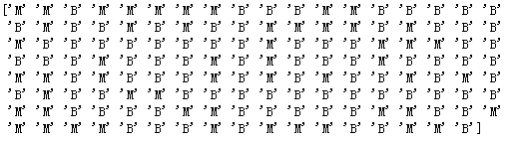
5.2.7 Predicting with a trained model
▼Chapter 5 Data analysis with Python
► 5.2 Machine learning with scikit-learn
In[19]:
y_predictSet = myModel.predict(X_testSet)
In[20]:
print(y_predictSet)

Slide 17
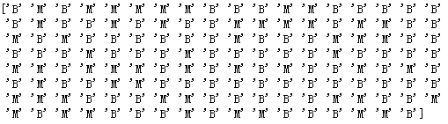
5.2.7 Predicting with a trained model
▼Chapter 5 Data analysis with Python
► 5.2 Machine learning with scikit-learn
In[21]:
print(y_testSet)

Slide 18
5.2.8 Model evaluation
▼Chapter 5 Data analysis with Python
► 5.2 Machine learning with scikit-learn
In[22]:
from sklearn.metrics import accuracy_score
print(accuracy_score(y_testSet, y_predictSet))
0.9370629370629371

Slide 19
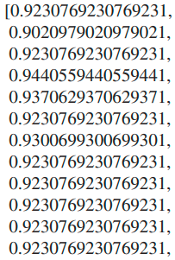
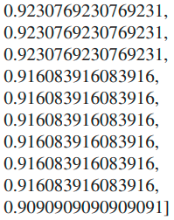
5.2.9 Model optimization and application
▼Chapter 5 Data analysis with Python
► 5.2 Machine learning with scikit-learn
In[23]:
from sklearn.neighbors import KNeighborsClassifer
NumberOfNeighbors = range(1,23)
KNNs = [KNeighborsClassifer(n_neighbors=i) for i in NumberOfNeighbors]
scores = [KNNs[i].ft(X_trainingSet, y_trainingSet).score(X_testSet,y_testSet) for i
in range(len(KNNs))]
scores

Slide 20
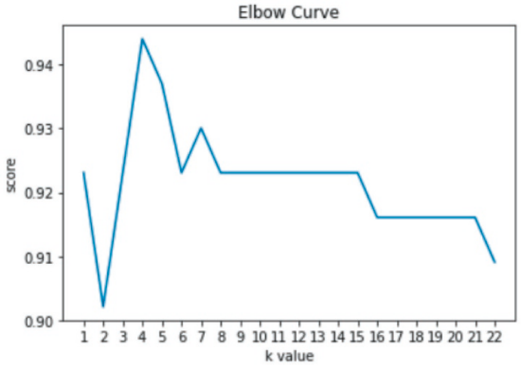
5.2.9 Model optimization and application
▼Chapter 5 Data analysis with Python
► 5.2 Machine learning with scikit-learn
In[24]:
import matplotlib.pyplot as plt
%matplotlib inline
plt.plot(NumberOfNeighbors,scores)
plt.rcParams['font.family'] = 'simHei'
plt.xlabel('k value')
plt.ylabel('score')
plt.title('Elbow Curve')
plt.xticks(NumberOfNeighbors)
plt.show()

Slide 21
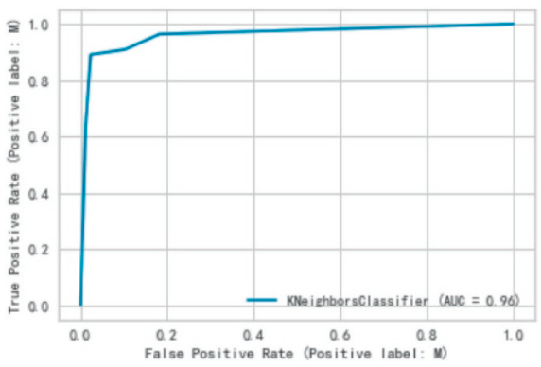
5.2.9 Model optimization and application
▼Chapter 5 Data analysis with Python
► 5.2 Machine learning with scikit-learn
In[25]:
import matplotlib.pyplot as plt
from sklearn import metrics
metrics.plot_roc_curve(myModel,X_testSet, y_testSet)
plt.show()

Slide 22


